Slide 1
Corona Travel
API Design

Slide 2
Product description
Our goal is to allow users to travel online from home via any device of their liking. They'll start by opening an app or a link and choosing a desired destination. After choosing a location, users can choose to view destination in 3D, look at some 3D photos or videos or learn some facts about the place.
Team: Sofya Donskaya, system analyst; Elena Karelina, backend developer; Danil Kireev, frontend developer; Artem Filimonov, backend developer + API integrator
Repo: https://github.com/randomunrandom/corona_travel
Report: https://docs.google.com/presentation/d/1b-Zt0XaH3pnYNZ3GRrrFuT_hIFIgmixB37lgc6IdhIs/edit?usp=sharing

Slide 3
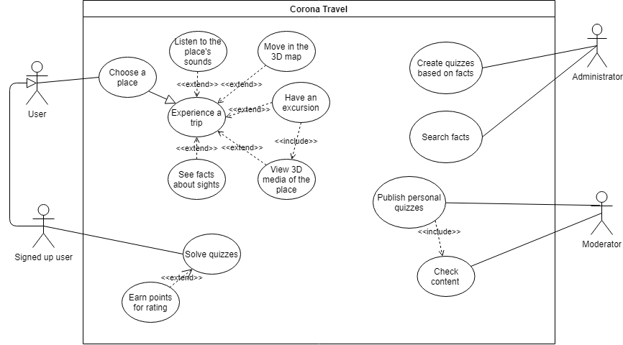
Use case diagram
Scenarios: https://github.com/randomunrandom/corona_travel/wiki/Scenarios

Slide 4
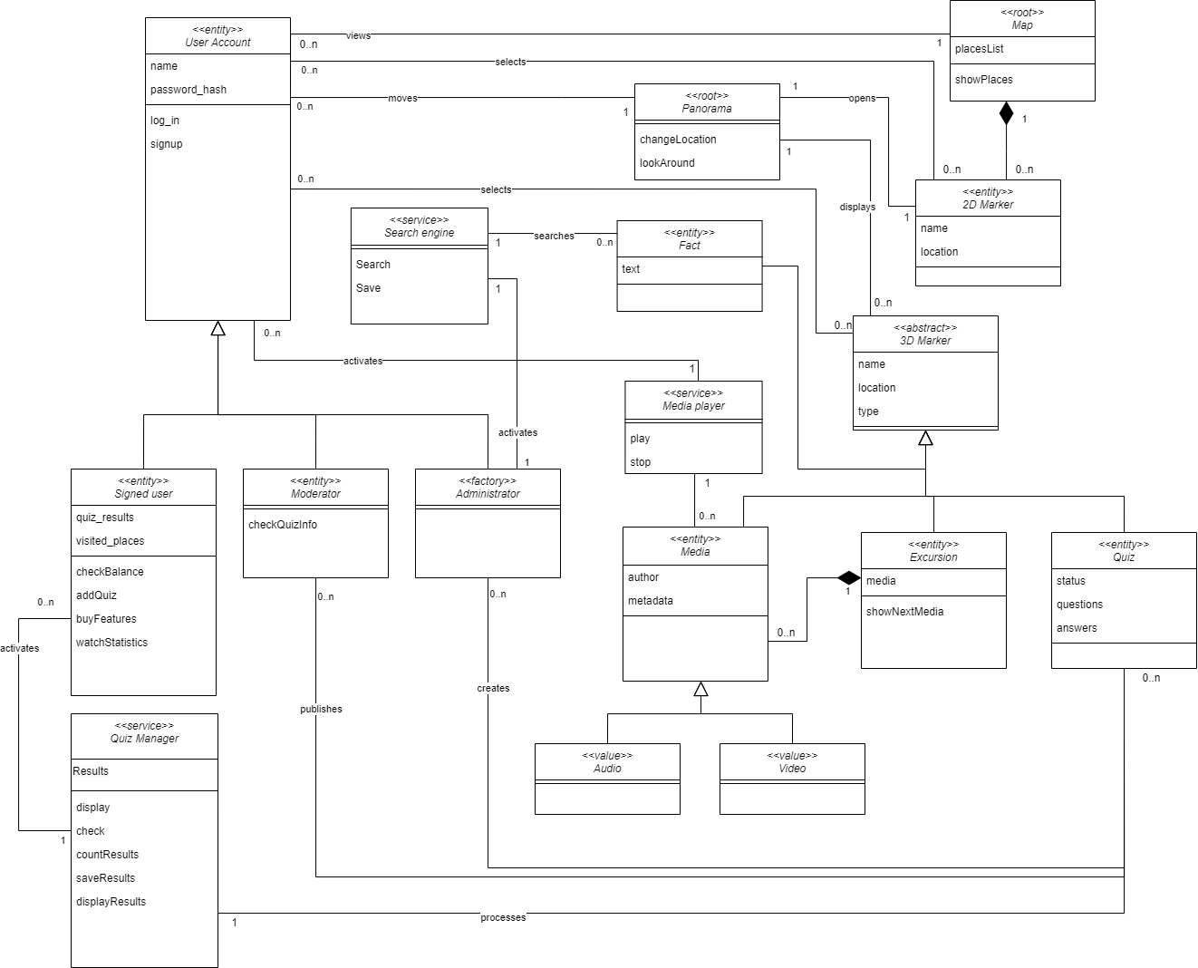
Detailed class diagram

Slide 5
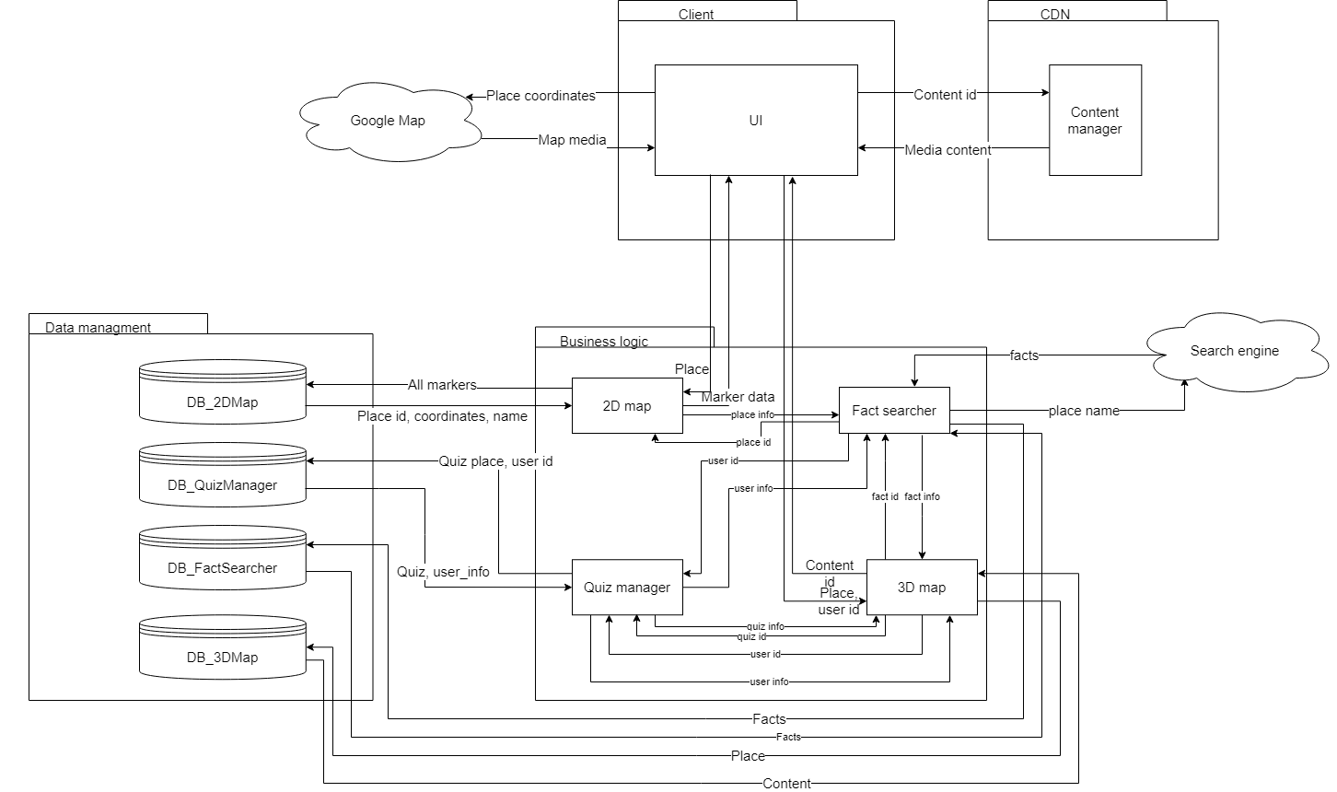
Service diagram

Slide 6
Open API
Using an Open API editor develop RESTful API for all microservices in the project, including data transfer objects. Store the API schema in your repository
https://raw.githubusercontent.com/randomunrandom/corona_travel/main/Task9/openapi.yaml

Slide 7
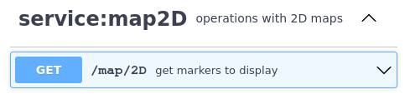
API usage <Service-Map2D>
Part of user story (Sergey)
User opens 2D map to see places that he visited, user selects a place on a map, user is reminded of his past

Slide 8
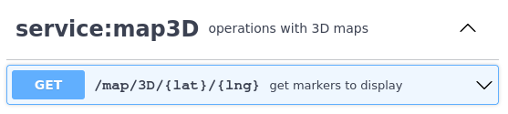
API usage <Service-Map3D>
Part of a scenario 2: User sees 3D Media of a place, clicks on any point of the area. The map shows the views of the selected place in map.

Slide 9
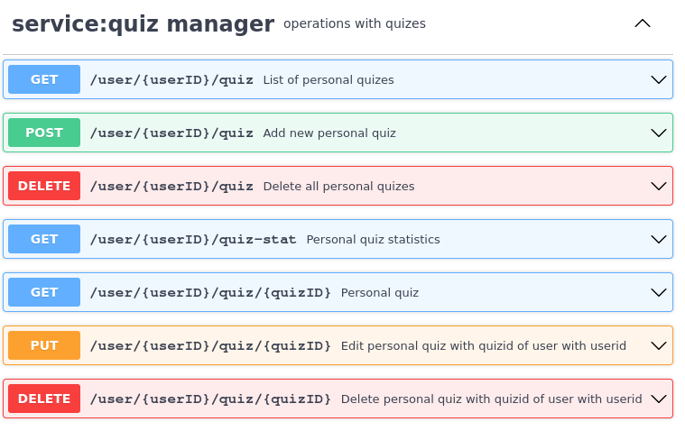
API usage <Service-QuizManager>
Part of scenario 5: User accepts the offer to have quiz. The system shows the list of questions for the quiz.

Slide 10
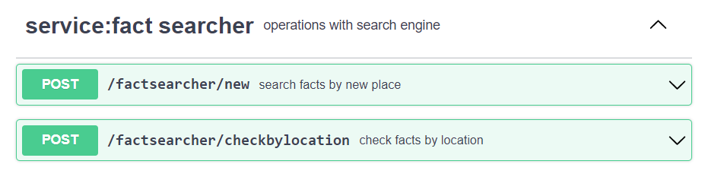
API usage <Service-FactSearcher>
Part of scenario 5: Administrator decides to add new place to the app. He adds place to the database and in order to find facts for new place he requests fact searcher via API. Facts are saved in database with relevant attributes.

Slide 11
Solution stack (prepare)
Implementation
API definition: OpenAPI
Connection server for API: python uvicorn
App framework: python FastAPI (ASGI)
Serialization/state format: json
Testing tools pytest
Operations
App initializer – none
Code build – No explicit build, project info with pyproject.toml
CI/CD pipeline – GitHub Actions
Delivery method – Docker
Monitoring – Grafana

